Slide 1

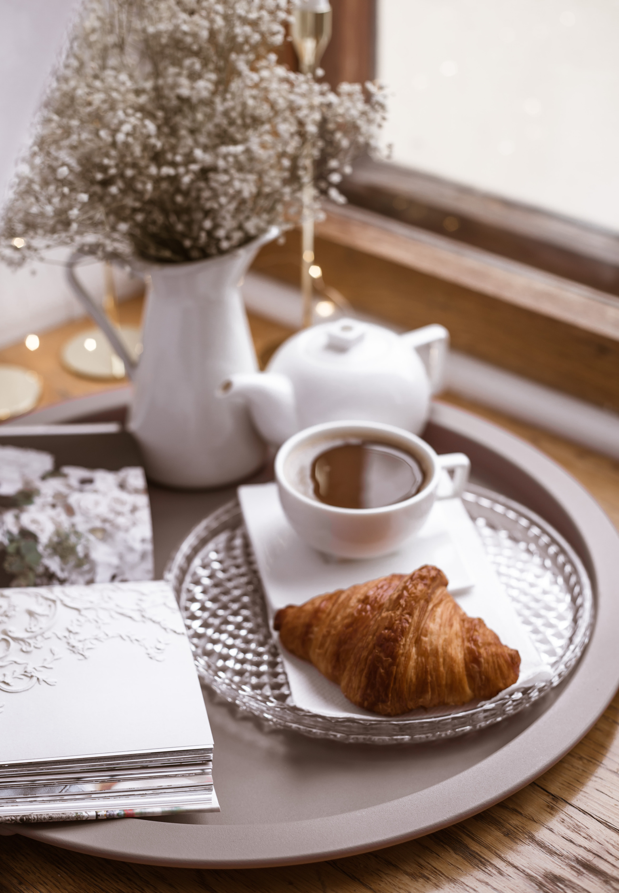


BRIGHT
COFFEE SHOP
Tasty and amazing Coffes brewed specifically for you!!
ORDER NOW
+27-456-7890
www.brightlightcoffee.com

Slide 2
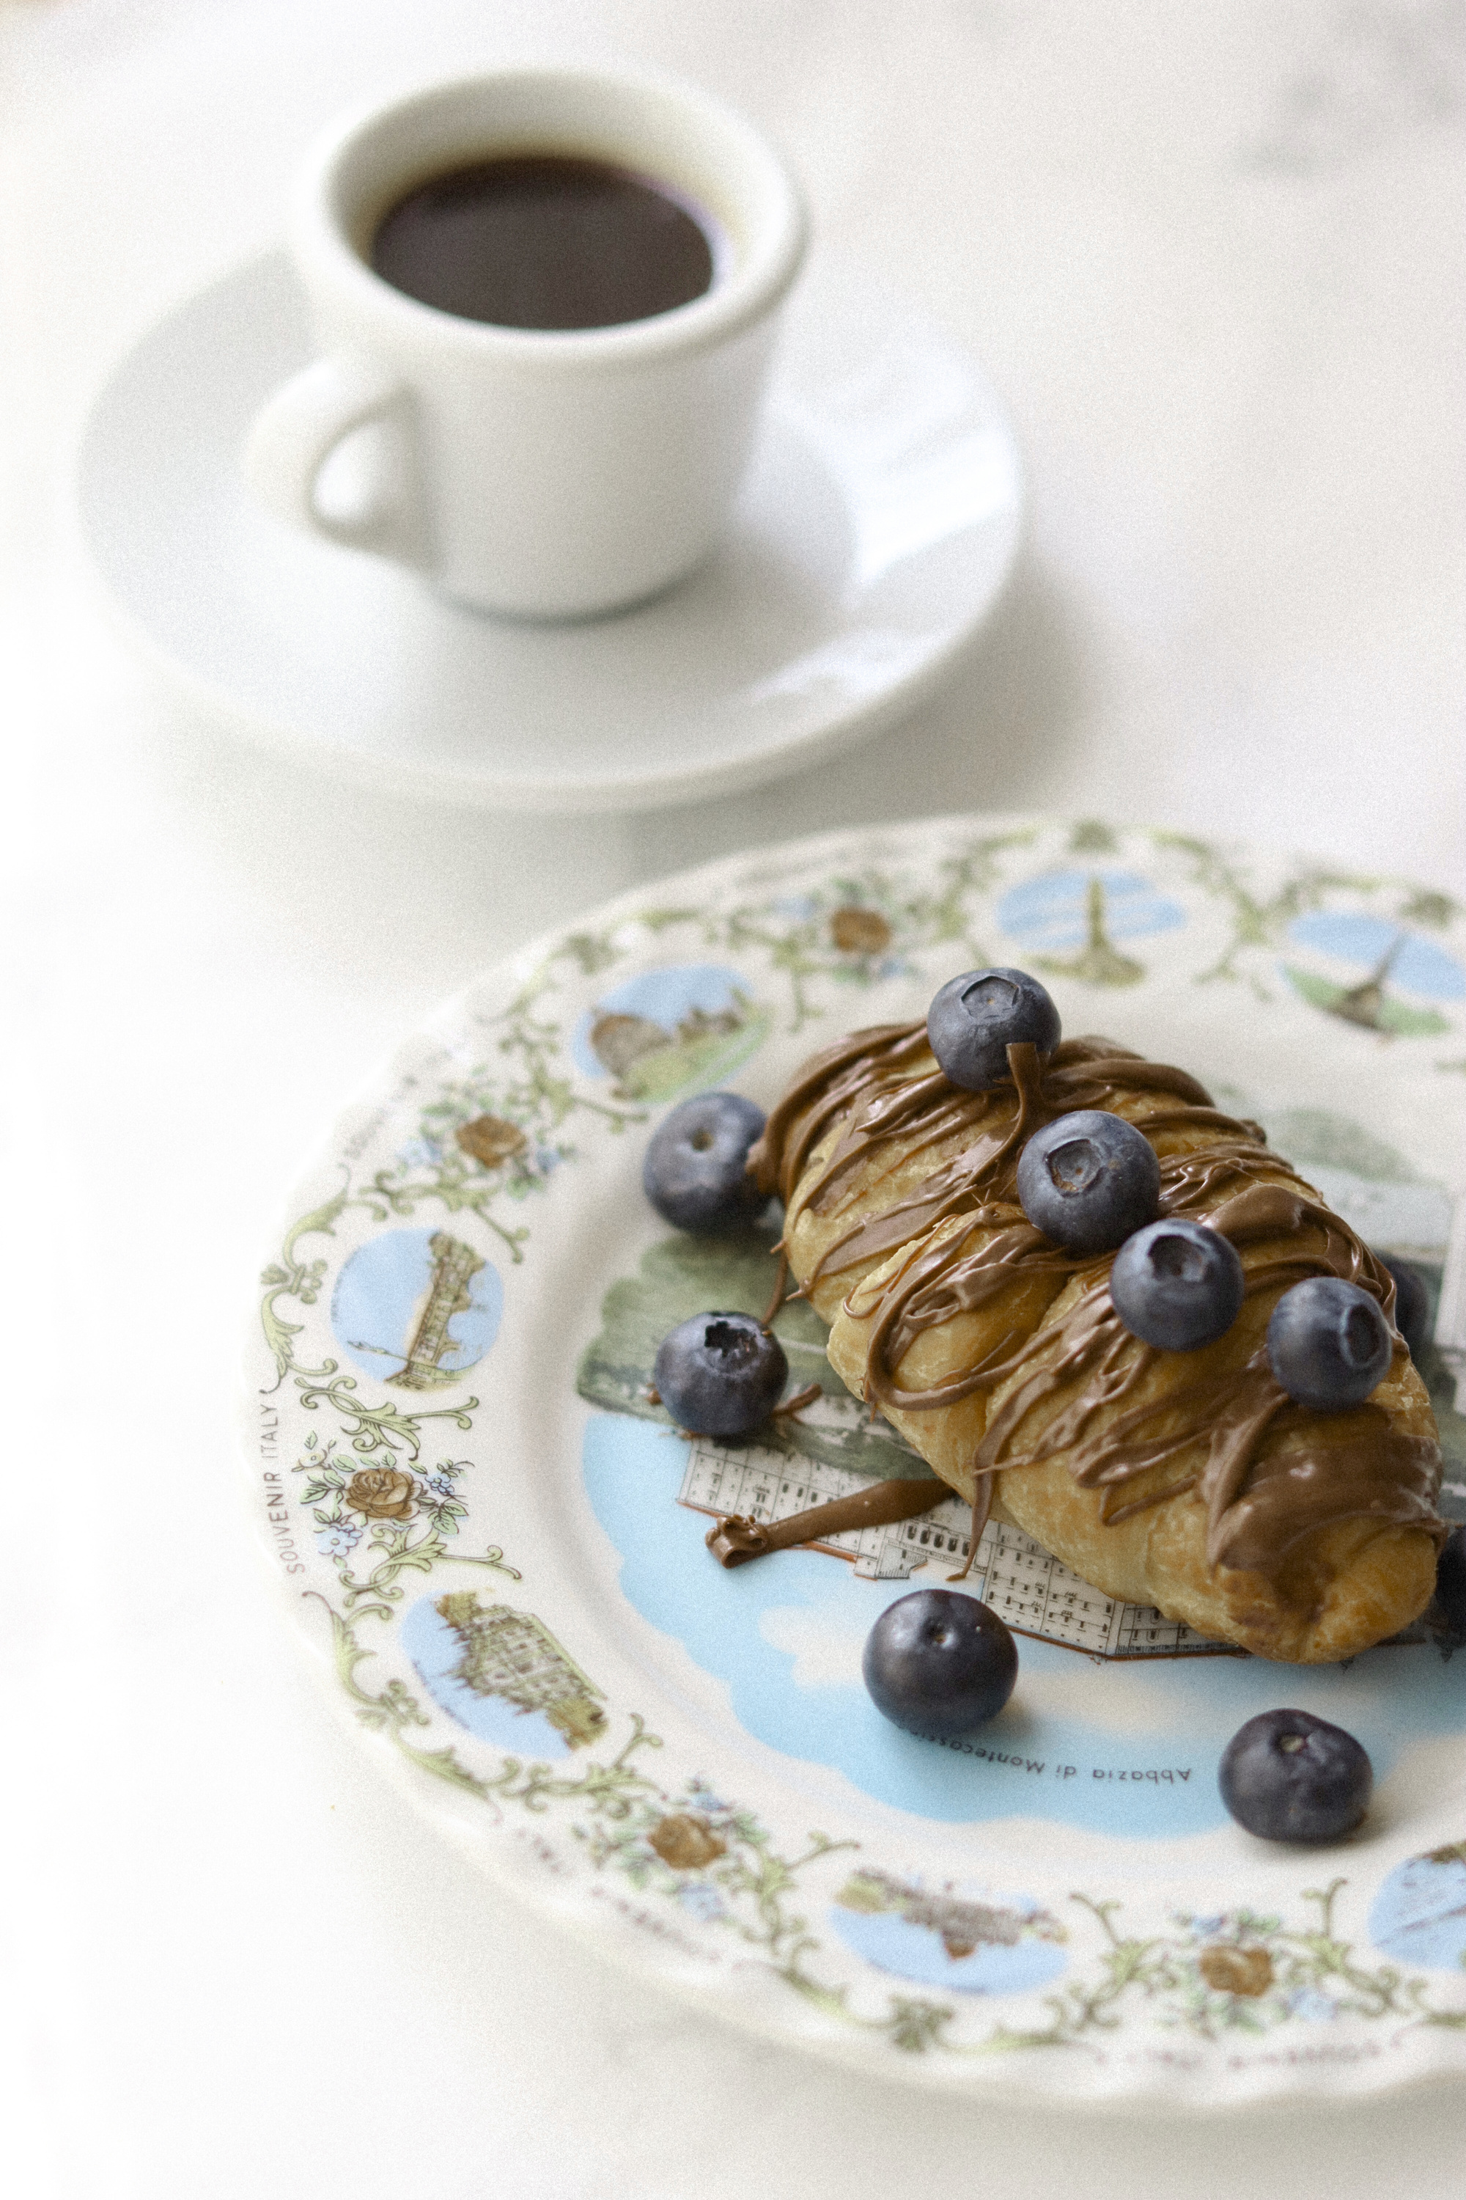
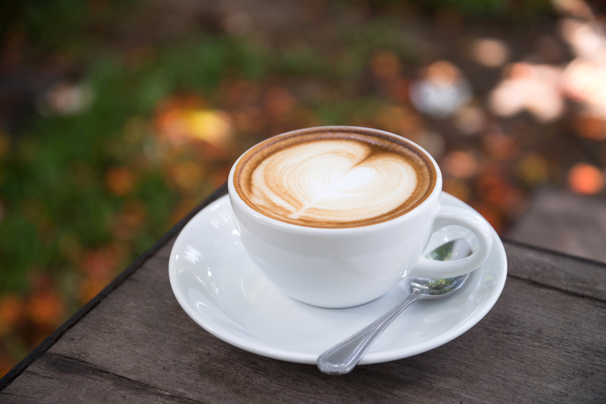
Introduction
This presentation will provide insights on how the coffee shop has been perfoming.
"A good day starts with a great cup of coffee/tea."

Slide 3
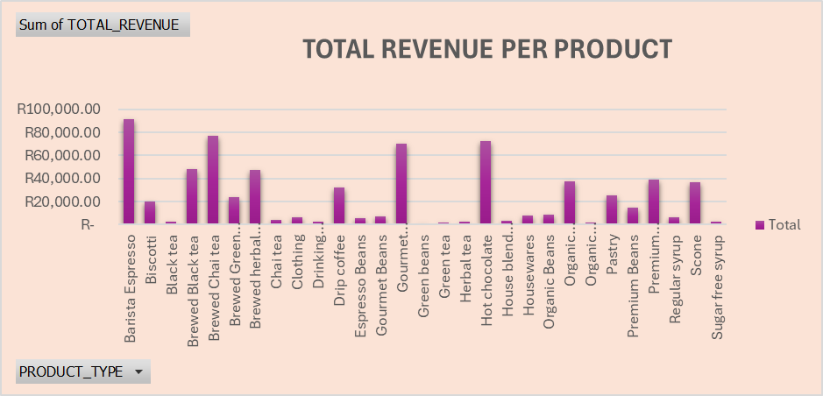
The graph below illustrate the total revenue per product in the coffee shop
The bar graph shows the total revenue the coffee shop made and all the product types that contributed to the revenue. The total revenue of the coffee shop is R698 812.33.

Slide 4
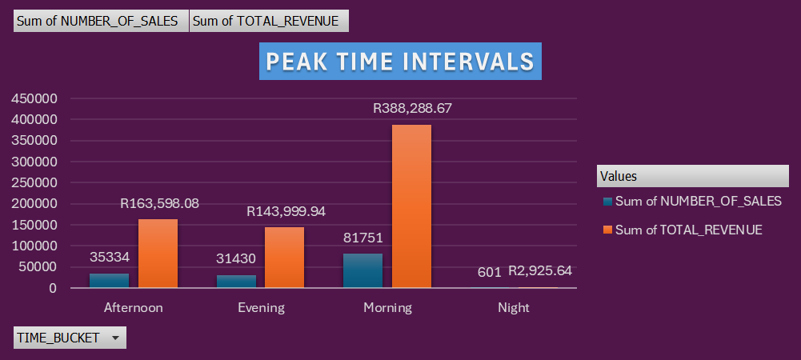
The graph below show the Peak Time Intervals in the coffee shop
The coffee shop makes high sales in the morning with 81 751 sales and R388 288.67 revenue. During the night the coffee shop performs poorly with 601 sales and R2 925.64 revenue. In the afternoon and evening, the coffee shop makes 35 334 and 31430 sales respectively.

Slide 5
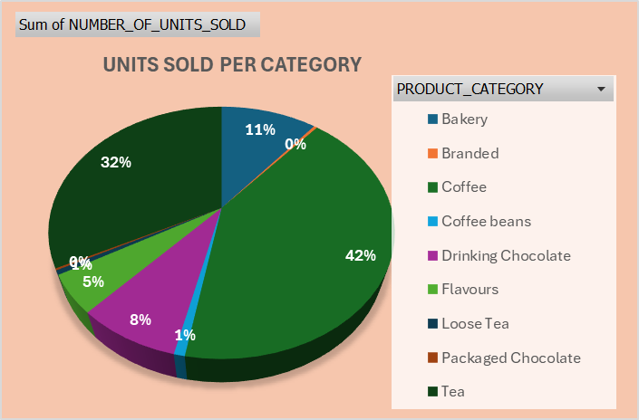
The bar graph below illustrate the total units sold by product category.
The products categories that sells the most is coffee with 41%, and tea with 32% of total units sold.
The least selling product categories are packaged chocolate, branded, and loose tea respectively.

Slide 6
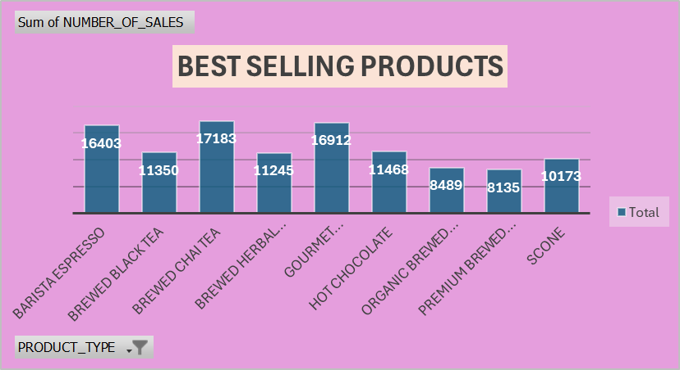
The graph below illustrate the best selling products in the coffee shop.
The top three selling products are, Brewed Chai Tea, Gourmet Brewed coffee, and Barista Expresso respectively.

Slide 7
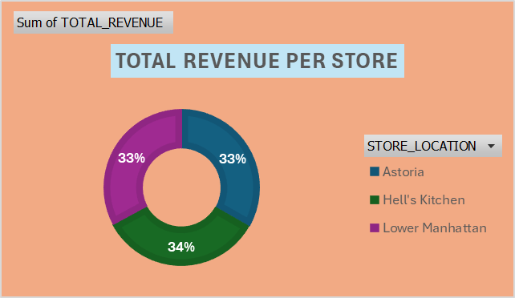
The bar graph below depicts the total revenue per store in the coffee shop
The store location that has high revenue is Hell’s Kitchen, followed by Astoria and Lower Manhattan. However, the high revenue of Hell’s kitchen is negligible because it’s difference is very little compared to other stores.

Slide 8
SUMMARY AND RECOMMENDATIONS
The coffee shop makes more money in the morning, so it would be better if more staff work in the morning and only few stuff at night. Having specials at night can also improve the night sales and perhaps the overall sales.
Promotions of low selling products should be considered, and the best selling products such as coffee and tea, must always be in stock to maximise profit.
All the three stores perform almost the same, so same ways of promoting sales can be used across all the brunches.

Slide 9
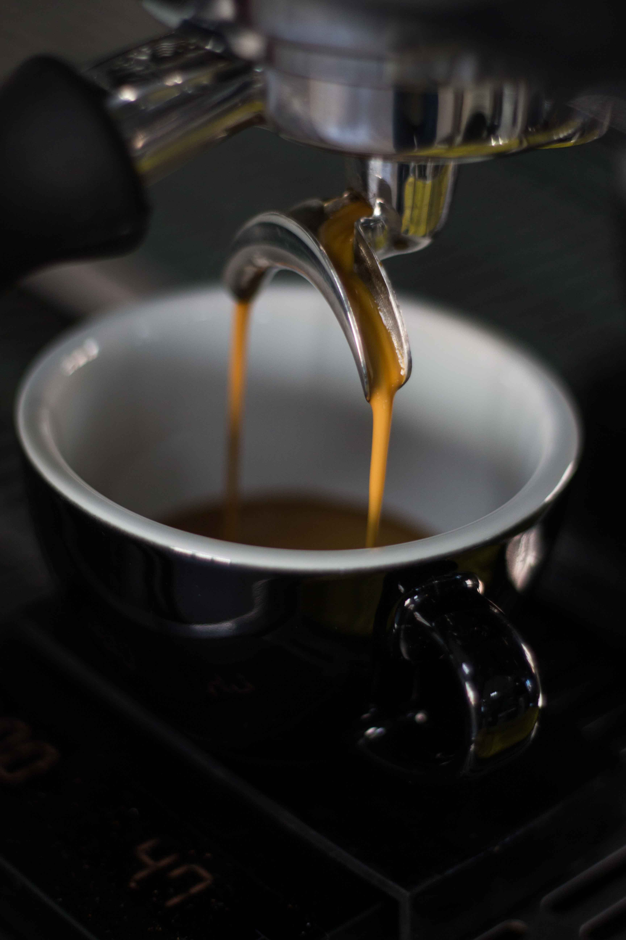
THANK YOU!
QUESTIONS AND ANSWERS??

